Slide 1
THEORY OF COMPUTATION
Group 2

Slide 2
Moore & Mealy Machine
What is a Mealy Machine?
A Mealy machine is a finite state machine where the output is determined by the current state and the current input.

Slide 3
One can describe a Mealy machine by a 6 tuple of Q, δ, Ʃ, O, X, q0. Here:
S is a finite set of states.
S₀ is the initial state.
X is a finite set of input symbols (input alphabet).
Y is a finite set of output symbols (output alphabet).
δ: S×X→S is the state transition function.
λ:S×X→Y is the output function.

Slide 4
Characteristics of a Mealy Machine:
A Mealy machine has fewer states as compared to a Moore machine.
Based on its present state and the current input, the Mealy machine alters its output.
It places its output on the transition.
The designing process doesn’t need to be very easy.

Slide 5
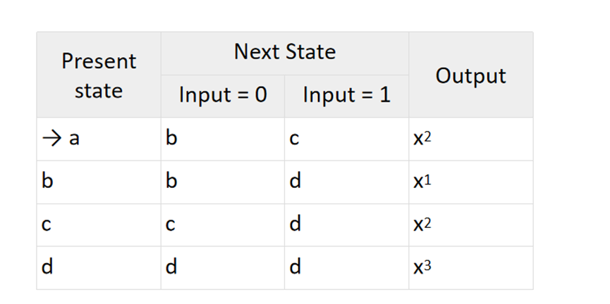

Slide 6
Moore Machine
What is a Moore Machine?
A Moore machine is a finite state machine where the output is determined only by the current state.

Slide 7
One can describe a Moore Machine by a 6 tuple of Q, δ, Ʃ, O, X, q0. Here:
S is a finite set of states.
S₀ ∈S is the initial state.
X is a finite set of input symbols (input alphabet).
Y is a finite set of output symbols (output alphabet).
δ:S×X→S is the state transition function.
λ:S→Y is the output function

Slide 8
Characteristics of a Moore Machine:
A Moore Machine consists of more states than the Mealy Machine.
Its output does not depend on the current input. It depends only on its current state.
It places its output on the transition.
IIt is very easy to design.
You can refer to the counter as a Moore Machine.

Slide 9
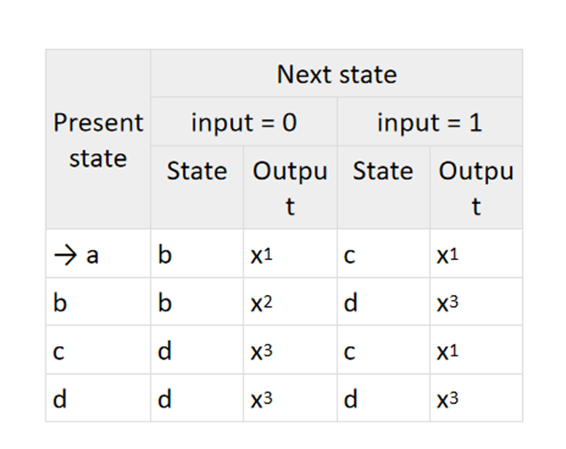

Slide 10
Difference Between Mealy Machine And Moore Machine
Parameters | Mealy Machine | Moore Machine
Definition | A Mealy Machine changes its output on the basis of its present state and current input. | A Moore Machine’s output depends only on the current state. It does not depend on the current input.
Output | Mealy Machine places its output on the transition. | Moore machine also places its output on the transition.

Slide 11
Introduction to Grammars in the Theory of Computation
Grammar is a set of rules that we use for proper conversation with each other, so in the same way as writing computer languages also there is a mathematical model of grammar which is used to write the languages correctly.
A grammar is represented by four tuples VIZ: G=(V,T,P,S)
V - Non Terminals (Uppercase)
T - Terminals (Lower case)
P - Set of rules.
S - Start symbol

Slide 12
Types of Grammars (Chomsky Hierarchy)
Type 0: Unrestricted Grammar
Type-0 grammars include all formal grammar. Type 0 grammar languages are recognized by the Turing machine. These languages are also known as the Recursively Enumerable languages.
The productions can be in the form of α → β The productions have no restrictions. Which means their is no restriction on α and β
Thus:
α → β, α, β ∈ (V U T), Which means there is no restriction on the combination of α and β.

Slide 13
Type 1: Context-Sensitive Grammar
Type-1 grammars generate context-sensitive languages. The language generated by the grammar is recognized by the Linear Bound Automata
In Type 1, First of all, Type 1 grammar should be Type 0.
Grammar Production in the form of α → β
α → β , |α| ≼ |β| And the left hand side comparisaly will have a non terminal
|β| length of β
|α| length of α
Example:
aA → bBC True
aA → b False

Slide 14
Type 2: Context-Free Grammar
Type-2 grammars generate context-free languages. The language generated by the grammar is recognized by a Pushdown automata.
In Type 2: First of all, it should be Type 1.
The left-hand side of production can have only one variable and there is no restriction on β
|α| = 1.
α → β , |α| ≼ |β|, α ∈ V, this means that belongs to V (Non terminals)
And we know that |α| = 1, so this means we should have only one variable in the left hand side.
Example:
S → abA True
S → A True
aS → abA False

Slide 15
Type 3: Regular Grammar
Type-3 grammars generate regular languages. These languages are exactly all languages that can be accepted by a finite-state automaton/Machine OR Finite Automata. Type 3 is the most restricted form of grammar.
The production is in the form:
α → β , where α / left hand side must be a non terminal (V) |α| = 1
In the form:
V --> VT / T (left-regular grammar)
(or)
V --> TV /T (right-regular grammar)
Example:
S → a/bA (left-regular grammar) S → a/Ab (right-regular grammar)

Slide 16
Importance in Theory of Computation
Language Recognition: Used to define formal languages recognized by automata.
Compiler Design: Essential for parsing and syntax analysis in programming languages.
Automata Theory: Helps in the study of pattern recognition and processing.
Complexity Theory: Aids in understanding computational complexity of languages.

Slide 17
LANGUAGE GENERATED BY GRAMMARS
Language generated by grammars means the sentences or strings that can be made using a set of rules called a grammar.
A grammar G is defined as a 4-tuple (N, Σ, P, S)
N is a finite set of non-terminal symbols.
Σ is a finite set of terminal symbols (alphabet), where N and Σ are disjoint.
P is a finite set of production rules of the form α→β, where α and β are strings consisting of terminals and/or non-terminals.
S is the start symbol, a special non-terminal from which production starts.

Slide 18
There are 3-types of languages generated by grammars:
Regular Grammar
Context-free Grammar
Content-sensitive Grammar
Type 3: Regular Grammar
Rules:
S→aS Start with an 'a' and keep adding 'a's.
S→b End with a 'b'.
Example Strings:
"b" (just ends with 'b')
"ab" (one 'a' followed by 'b')
"aab" (two 'a's followed by 'b')
"aaab" (three 'a's followed by 'b')
This grammar makes strings with any number of 'a's followed by a single 'b'.

Slide 19
Type 2: Context-Free Grammar
Rules:
S→aSb For every 'a' we add at the start, we must add a 'b' at the end.
S→ϵ(empty string) We can stop when we want.
Example Strings:
"" (empty, nothing at all)
"ab" (one 'a' followed by one 'b')
"aabb" (two 'a's followed by two 'b's)
"aaabbb" (three 'a's followed by three 'b's)
This grammar makes strings where the number of 'a's is the same as the number of 'b's, and all 'a's come before the 'b's.

Slide 20
Type 1: Context-Sensitive Grammar
Rules:
S→aSBC (Start with 'a', 'S', 'B', and 'C'.)
CB→BC Change 'CB' to 'BC'.
aB→ab Change 'aB' to 'ab'.
bB→bb Change 'bB' to 'bb'.
bC→bc Change 'bC' to 'bc'.
cC→cc Change 'cC' to 'cc'.
a→ϵ
S→a
Example Strings:
"abc" (one 'a', one 'b', one 'c')
"aabbcc" (two 'a's, two 'b's, two 'c's)
"aaabbbccc" (three 'a's, three 'b's, three 'c's)
This grammar makes strings where the number of 'a's, 'b's, and 'c's are all the same.

Slide 21
Type 0: Unrestricted Grammar
Rules:
S→0S1 For every '0' we add at the start, we must add a '1' at the end.
S→01 We can stop when we want.
Example Strings:
"01" (one '0' followed by one '1')
"0011" (two '0's followed by two '1's)
"000111" (three '0's followed by three '1's)
This grammar makes strings where the number of '0's is the same as the number of '1's.
This means we make strings where the number of '0's is the same as the number of '1's, like "0011"

Slide 22
Differences Among Grammar Types
Power and Expressiveness:
•Type 0 (Unrestricted): Most powerful, can describe any computable language.
•Type 3 (Regular): Least powerful, used for simple pattern matching like regular expressions.
Production Rules:
•Type 0: No restrictions on production rules.
•Type 1: Rules must maintain or increase the length of the string.
•Type 2: Single non-terminal on the left-hand side.
•Type 3: Specific forms (A → aB or A → a).

Slide 23
Applications:
•Type 0: General computation (Turing machines).
•Type 1: Natural language processing, complex languages.
•Type 2: Programming languages, syntax trees.
•Type 3: Finite automata, lexical analysis.
Computational Models:
•Type 0: Turing machines.
•Type 1: Linear-bounded automata.
•Type 2: Pushdown automata.
•Type 3: Finite state automata.

